Slide 1
Facial recognition technology
1309 Ye-Won Shin
1502 Na-Yun Kim

Slide 2
INDEX
Implementation
- Weaknesses
- Supplementation
- Applications

Slide 3
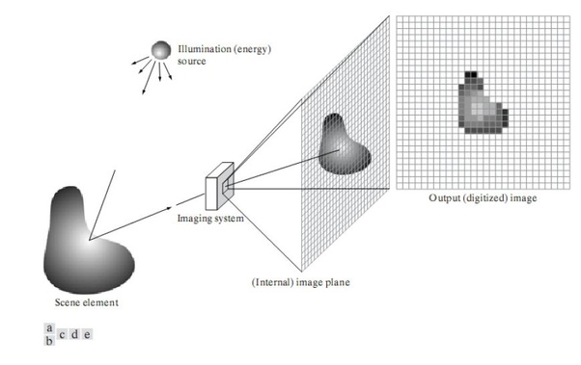
1. Implementation
① Image acquisition
The creation of a digitally encoded representation of the visual characteristics of an object, such as a physical scene or the interior structure of an object.
Facial-scan technology can acquire faces from almost any static camera or video system that generates images of sufficient quality and resolution.
High quality enrollment is essential to eventual verification and identification enrollment images define the facial characteristics to be used in all future authentication events.

Slide 4
1. Implementation
② Image processing
A method to convert an image into digital form and perform some operations on it in order to get
an enhanced image
Images are cropped such that the facial image remains, and color images are normally converted to
black and white in order to facilitate initial comparisons based on grayscale characteristics.
First the presence of faces or face in a scene must be detected. Once the face is detected, it must be
localized and normalization process may be required to bring the dimensions of the live facial sample
in alignment with the one on the template.

Slide 5
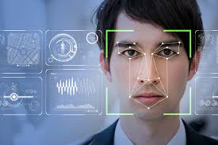
1. Implementation
③Finding distinctive characteristic location
All facial scan systems attempt to match visible facial features in a fashion similar to the way people
recognize one another.
The features most often utilized in facial scan systems are those least likely to change significantly over time like nose shape or the sides of the mouth.

Slide 6
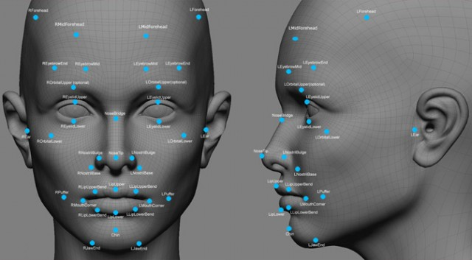
1. Implementation
④ Creating template
Enrollment templates are normally created from a multiplicity of processed facial images.
These templates can vary in size from less than 100 bytes, generated through certain vendors and to over 3K for templates which is the largest among technologies considered physiological biometrics.

Slide 7
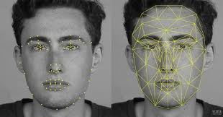
1. Implementation
⑤ Matching template
Compares match templates against enrollment templates.
A series of images is acquired and scored against the enrollment, so that a user attempting 1:1 verification within a facial-scan system may have 10 to 20 match attempts take place within 1 to 2 seconds.

Slide 8
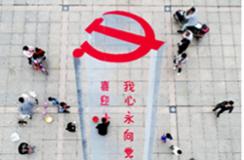
2. Weaknesses
Changes in acquisition environment reduce matching accuracy.
Changes in physiological characteristics reduce matching accuracy.
Has the potential for privacy abuse due to noncooperative enrollment and identification capabilities.
ex) China social credit system
They use facial recognition for credit system. But, if this system be hacked, it could increase corruption. Also this system has lack of freedom. If they don’t make a solution they will lose there privacy.

Slide 9
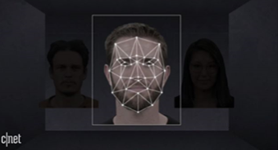
3. Supplementation
It uses light to recognize our face. They don’t leave photo so it can prevent leaking information. In recent facial recognition, it uses distance of pore. Therefore, we can’t access it unauthorized.
NEC, a long time committed pioneer of biometric research and solutions has developed multi-model technologies including face, iris and voice recognition, finger and palmprint identification, and ear acoustic authentication, and supplemented them with AI and data analytics to enhance situational awareness and for the accuracy of the technology.

Slide 10
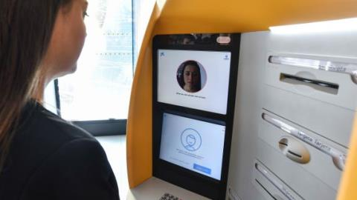
4. Applications
-Banking using ATM
The Face Detection module analyzes the picture taken by the ATM camera, recognizes if a person’s face is pictured and determines whether it is covered or not.
The software uses sophisticated face recognition algorithms that analyze 4000 points of the human face, therefore, the results are accurate and reliable. If for some reason, the face of the ATM user is not detected or covered with anything at the start of a transaction, then the terminal stops the service.

Slide 11
Thank you for listening

